Slide 1
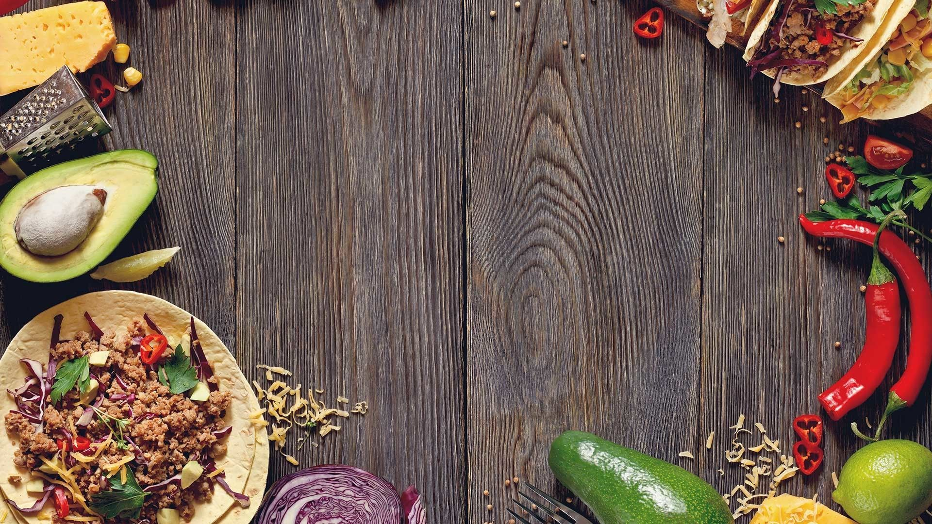
Mexican Food Recipes
By Group-5

Slide 2
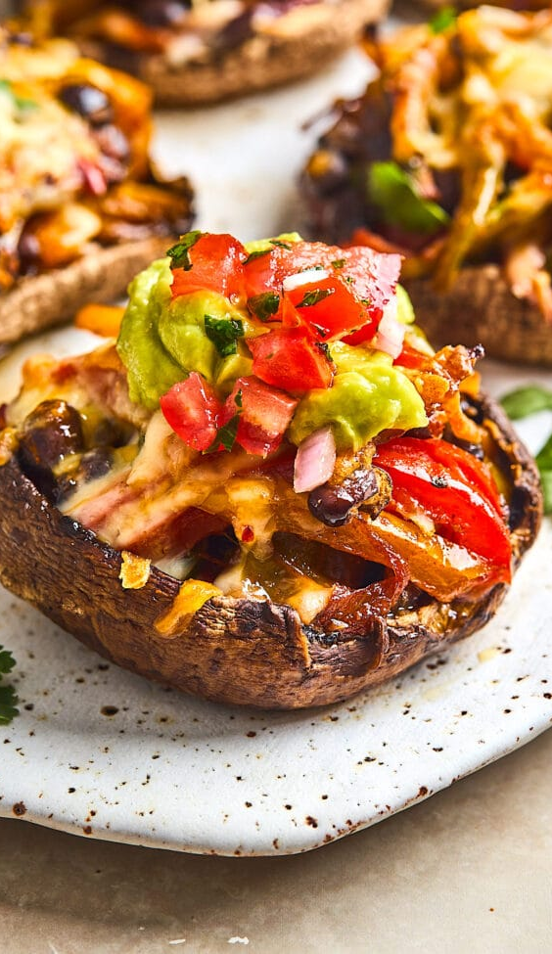
Introduction
Welcome to our presentation on our website for authentic Mexican food recipes.
Our goal is to create a platform that celebrates the rich culinary heritage of Mexico and makes it accessible to food enthusiasts worldwide.
Mexico's cuisine is renowned for its vibrant flavors, diverse ingredients, and centuries-old traditions, making it a treasure trove for food lovers.
However, we noticed a lack of comprehensive resources that truly capture the essence of Mexican cuisine and provide reliable, authentic recipes.
With our website, we aim to bridge this gap by offering a one-stop destination for anyone passionate about exploring and mastering the art of Mexican cooking.

Slide 3
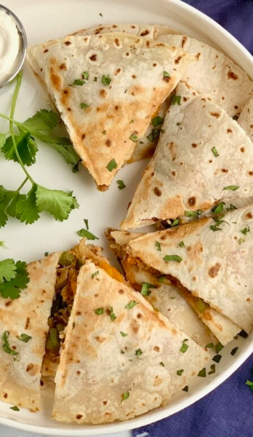
Problem Statement
Mexican cuisine is renowned for its bold flavors and vibrant ingredients, but it can be challenging for people to find reliable and authentic recipes.
Many existing recipe websites lack the depth, cultural context, and diversity necessary to truly capture the essence of Mexican cuisine.
We identified a need for a comprehensive online resource that not only presents a wide range of traditional Mexican food recipes but also educates and immerses users in the rich culinary heritage of Mexico.
To address this gap, we have developed a user-friendly website that caters to both beginners and seasoned chefs searching for authentic Mexican recipes..

Slide 4
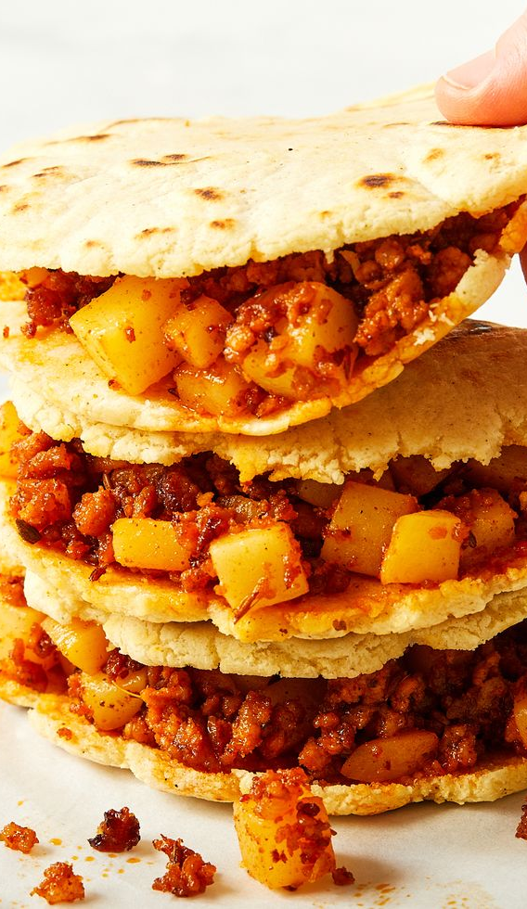
Our Solution
We have developed a user-friendly website that caters to both beginners and seasoned chefs searching for authentic Mexican recipes.
Our platform offers a vast collection of traditional recipes from various regions of Mexico.
Each recipe is carefully curated and includes detailed instructions, and ingredient lists to ensure a successful cooking experience.

Slide 5
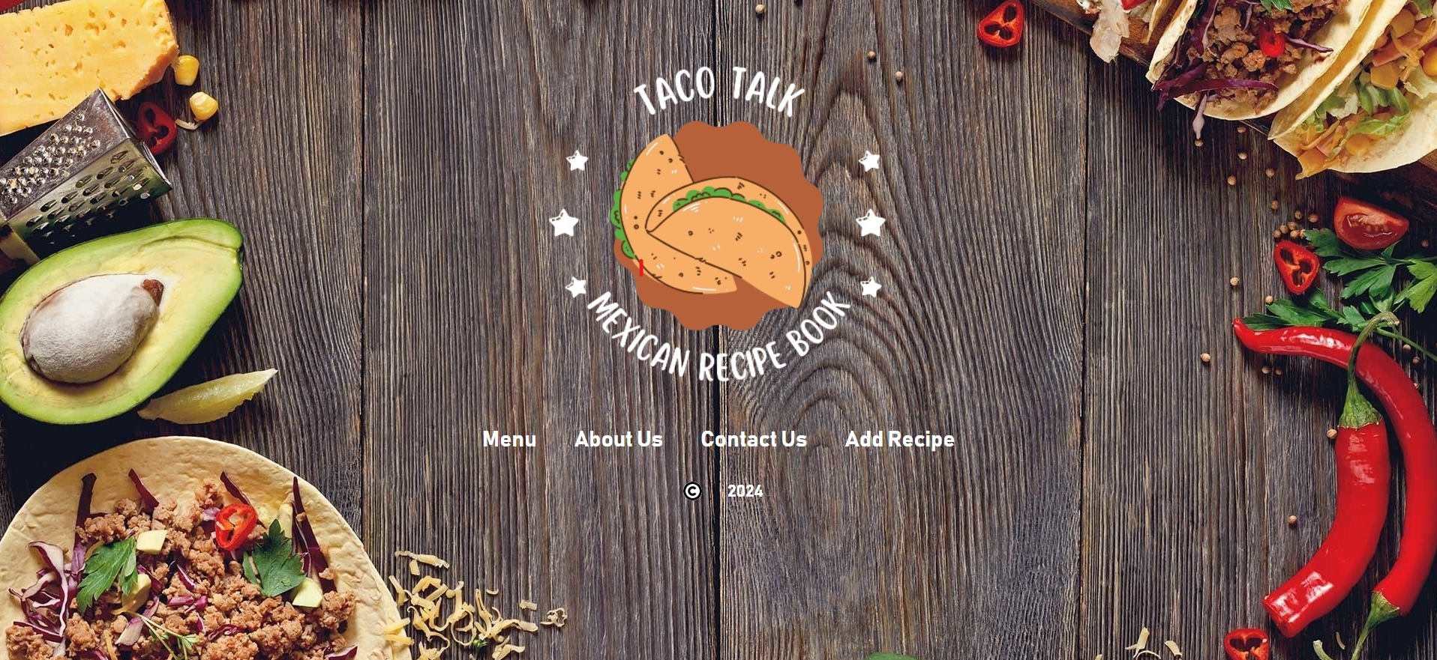
Home Page

Slide 6
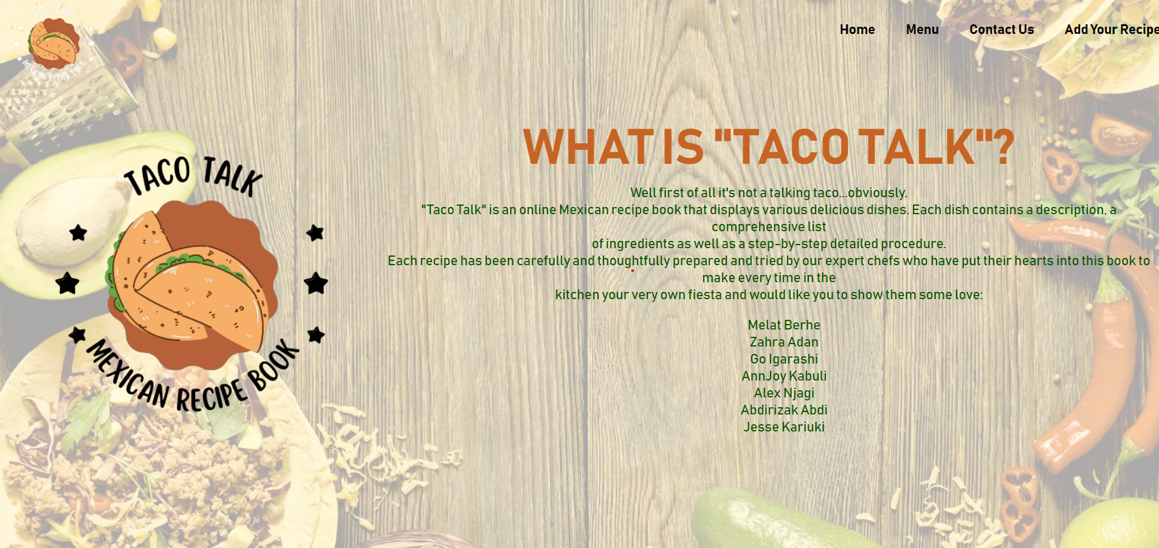
About US

Slide 7
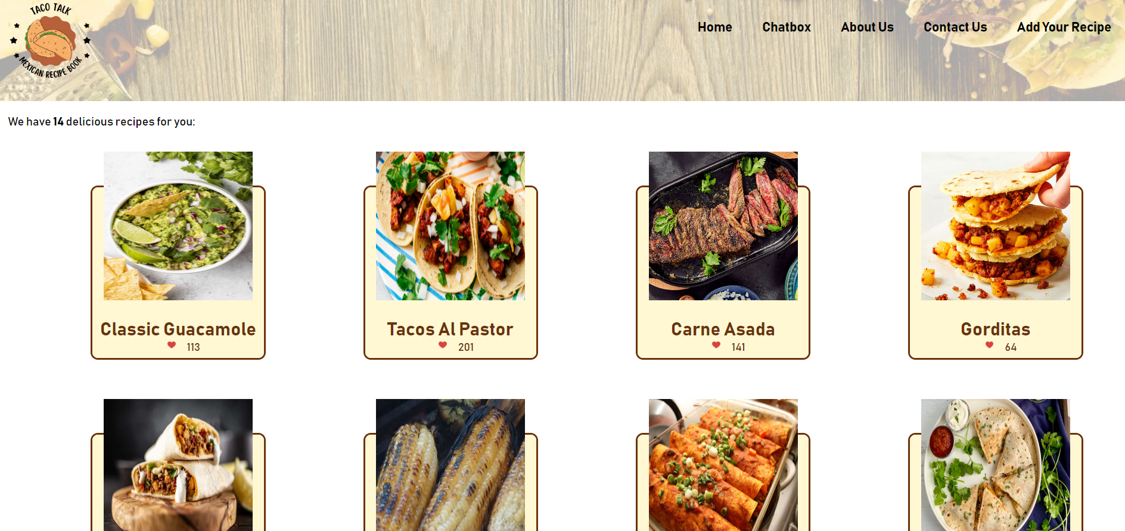
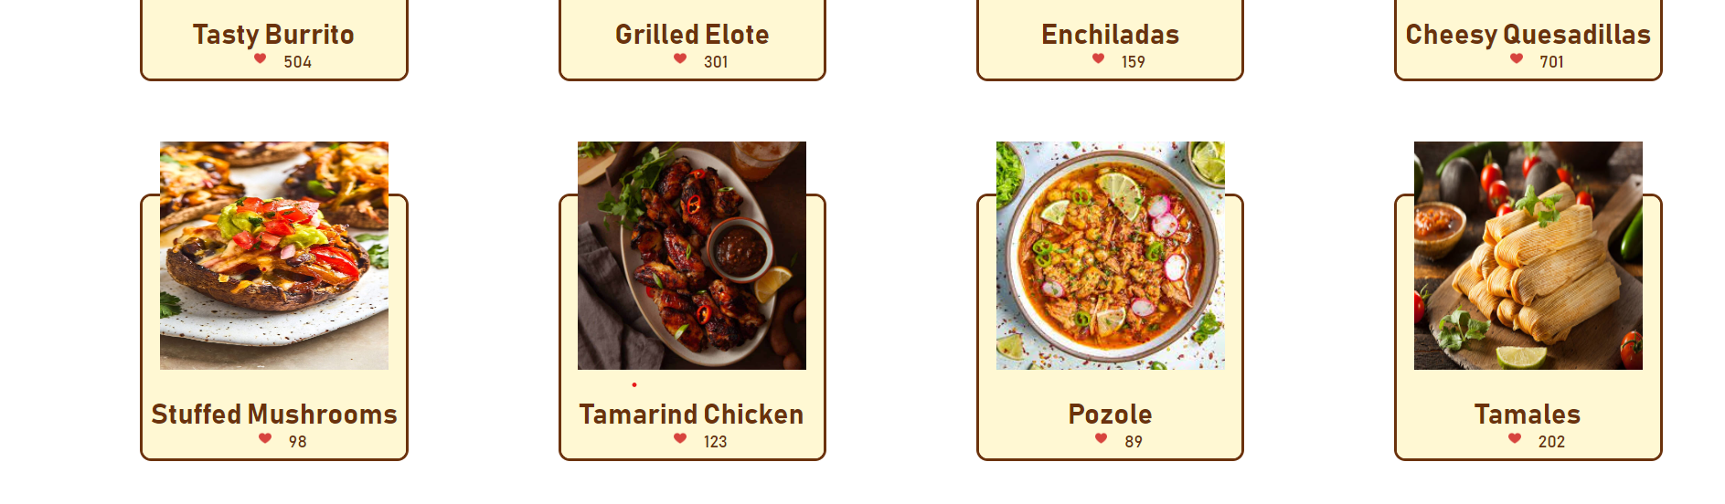
Recipe

Slide 8
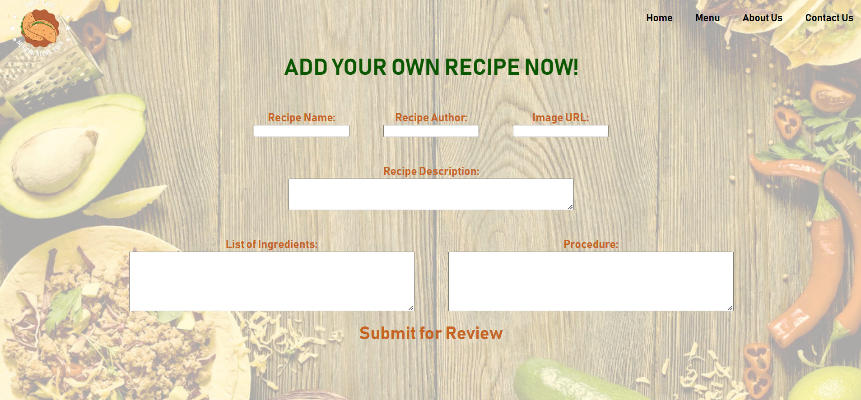
Add Your Recipe

Slide 9

Contact US

Slide 10
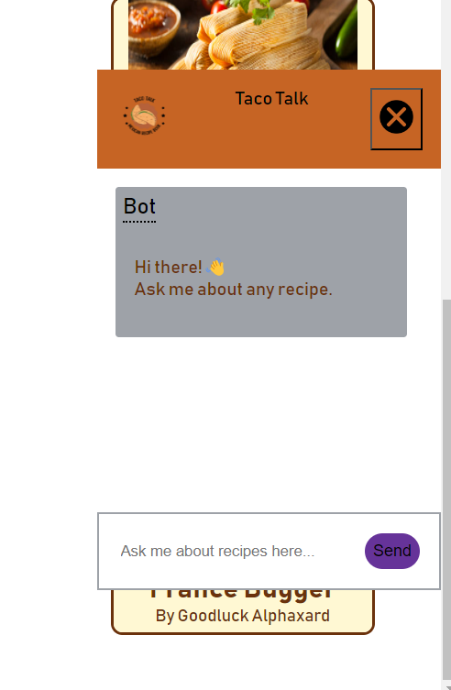
Chat Bot
provides instant assistance, personalized recommendations, and interactive cooking experiences, enhancing the user experience and engagement.

Slide 11
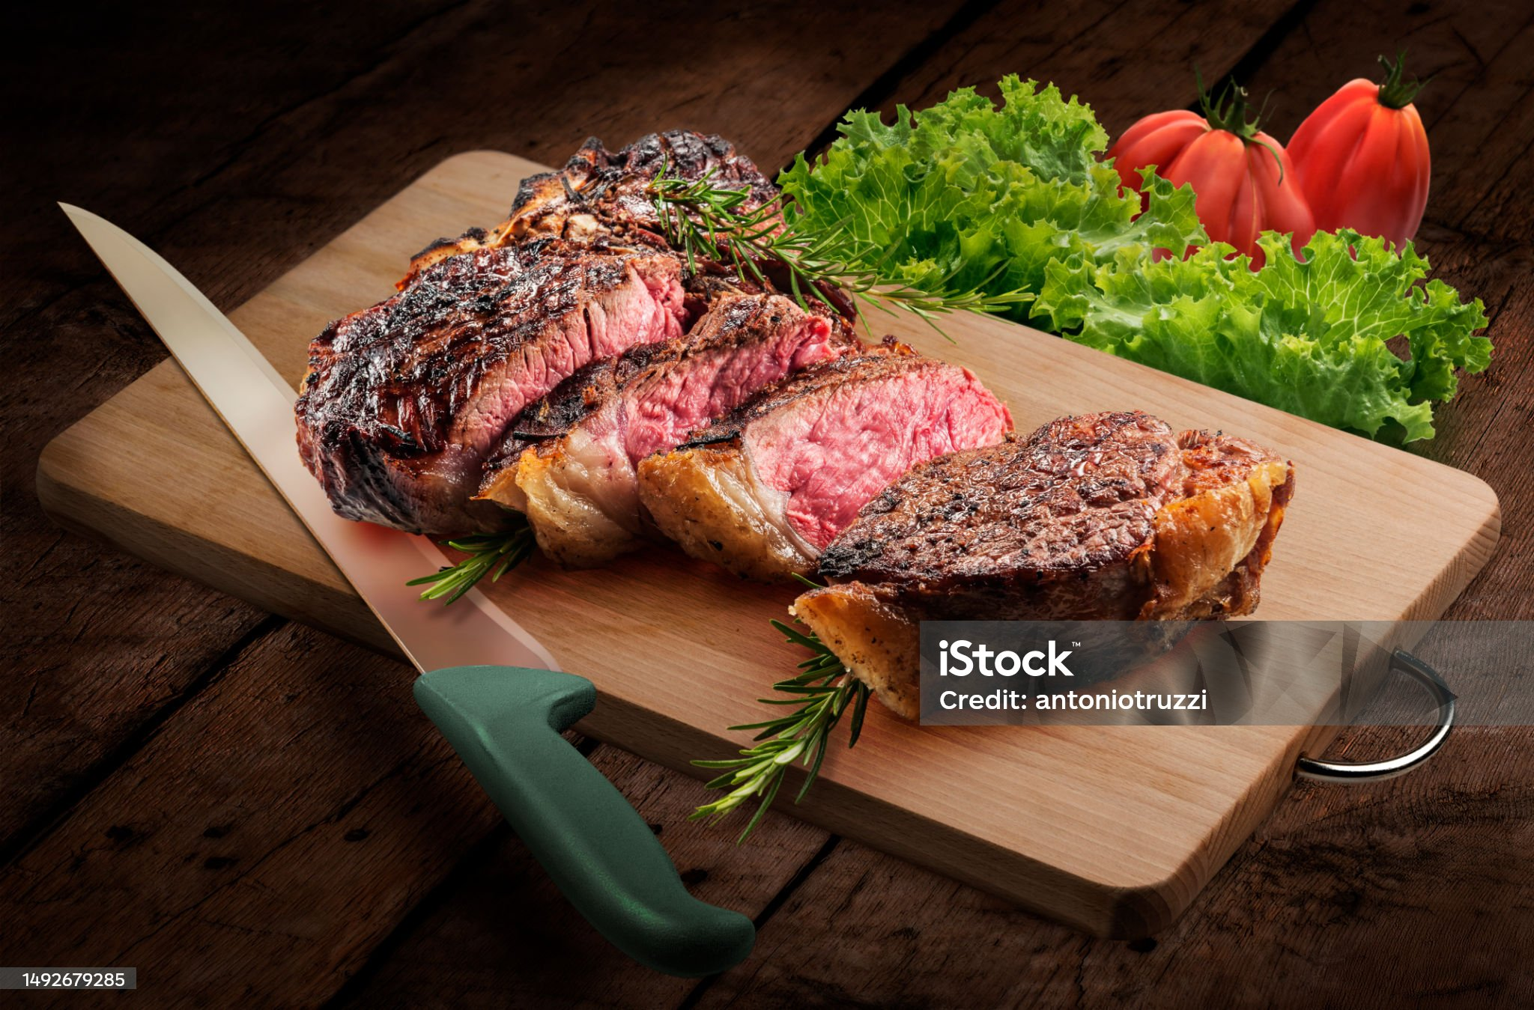
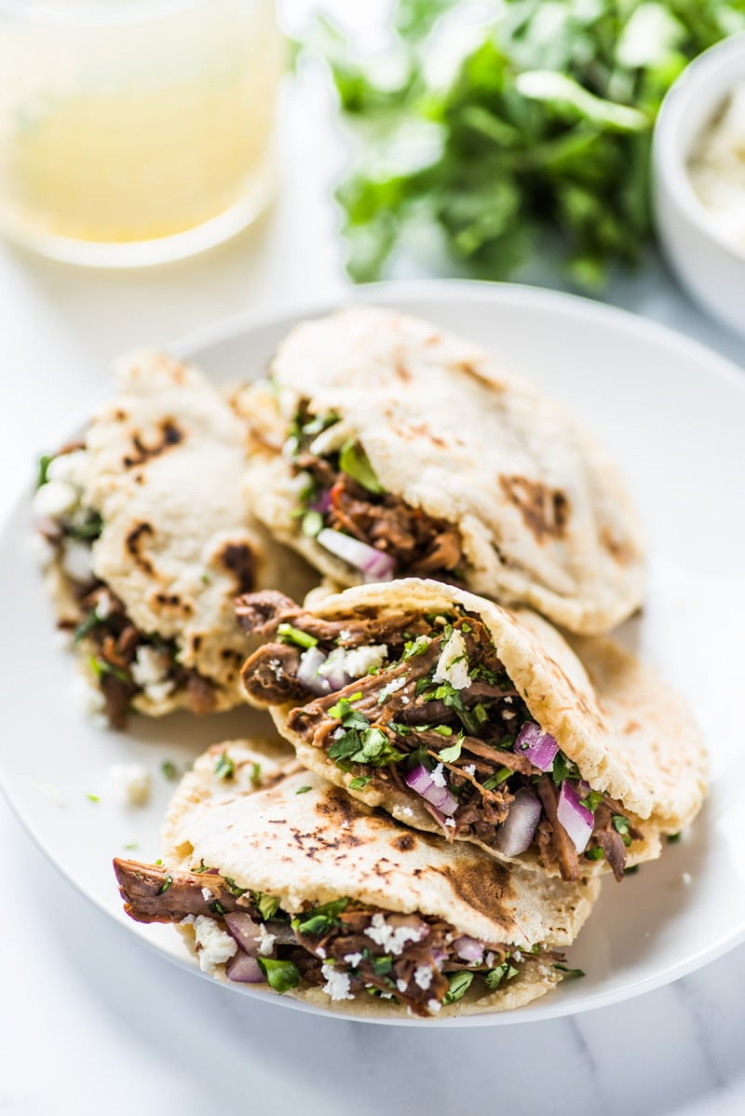
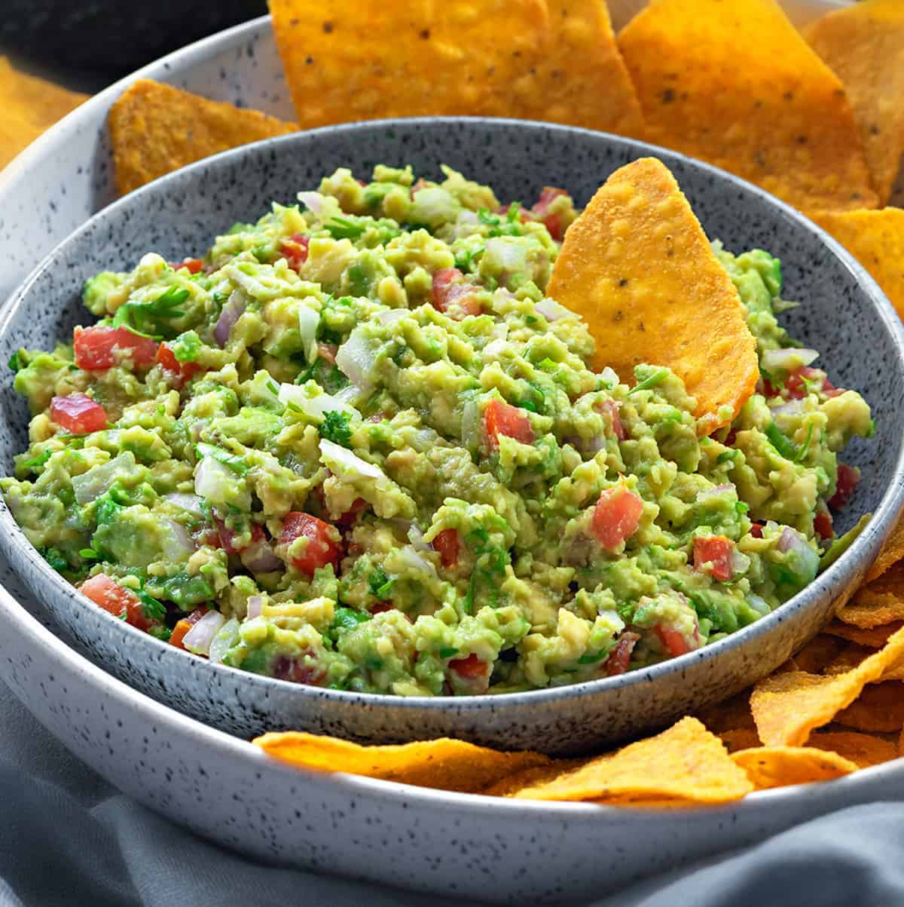
Conclusion
Our website for authentic Mexican food recipes is the ultimate destination for anyone seeking to explore the diverse and delicious world of Mexican cuisine.
We aim to inspire and empower individuals to create restaurant-quality meals in their own kitchens.
Whether you are a novice cook looking to expand your culinary horizons or an experienced chef seeking new inspiration, our website will be your trusted companion in your exploration of authentic Mexican cuisine.

